Slide 1

A Socially Relevant Project -I Presentation on IoT based Fire Alarm System Presented by the Batch Saladagu Deepthi 19121A1594 Mitta Devi Sahithi 19121A1569 Sunkesula Ansari 19121A15A7 Shaik Bunglow Samreen 19121A15A0
Computer Science and Systems Engineering
Under the guidance of
K.Pujitha
Assistant Professor
Dept. of CSSE
HOD:
Dr. A. Balasubramani,
Professor & Head,
Dept. of CSSE

Slide 2
CONTENTS
Abstract
Objectives
Analysis
Design
Implementation
Results
Applications
Limitations
Conclusion and Future Work

Slide 3
Abstract
Fire is the most widespread cause of death by accident. Fire affects thousand of residents each year, resulting in injury and loss of life. In this project, an Internet of Things (IoT) based Fire Detection System is designed to prevent people from fire by providing an alert message in the emergency. The system is designed using (temperature) sensors embedded with NodeMCU to get the fire event information in the surrounding more accurately. This research distinguishes the conditions in a surrounding as fire, no fire, and may be fire. It is used for classification, and if fire conditions arise then a safety message is sent to the registered mobile number using Python programming.

Slide 4
Objectives
The aim of this project is to provide a reliable and swift responsive fire alarm system through the use of SMS.
To design and construct a fire alarm for a building that will detect the presence of fire accident in the building.
To provide cost-effective fire alarm system which performs reliably to ensure safety from fire.
Larger scale industrial or residential area can be monitored through the proposed system installing multiple modules, each for one floor or unit.
To avoid financial loss and also save people from dangerous fire accidents.

Slide 5
Analysis

Slide 6
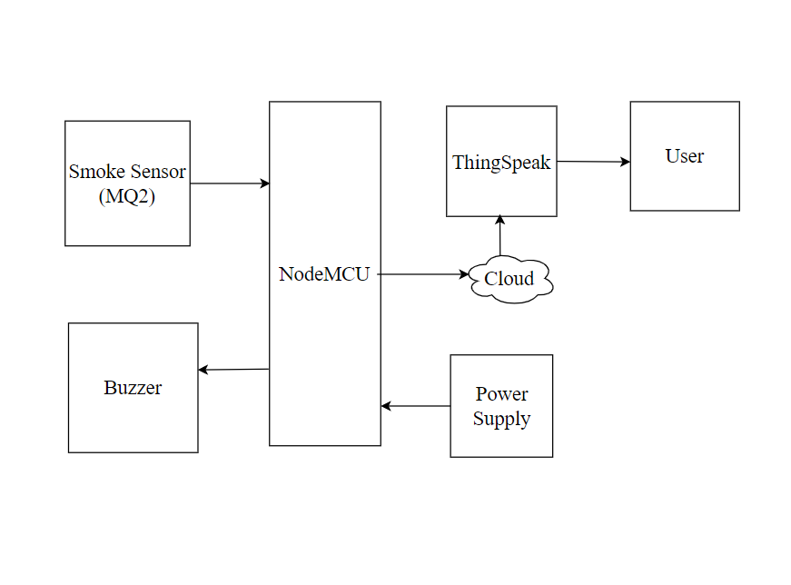
Block Diagram

Slide 7
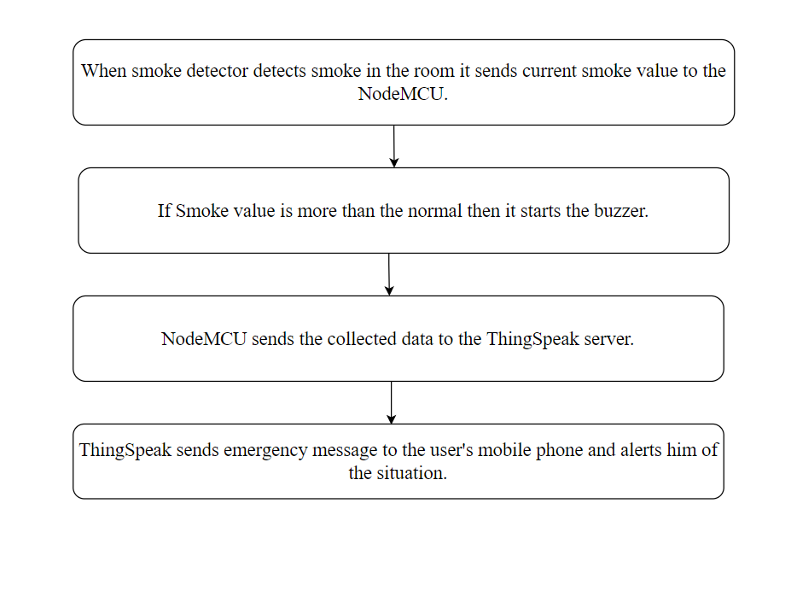
Flow Chart

Slide 8
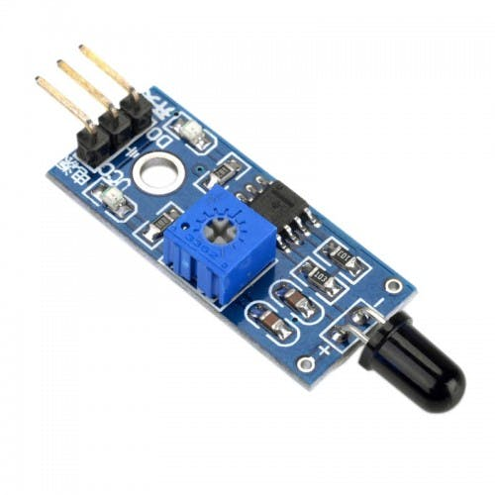
Design
Flame Sensor
A Flame Sensor is a device that can be used to detect presence of a fire source or any other bright light sources.
There are several ways to implement a Flame Sensor but the module used in this project is an Infrared Radiation Sensitive Sensor.

Slide 9
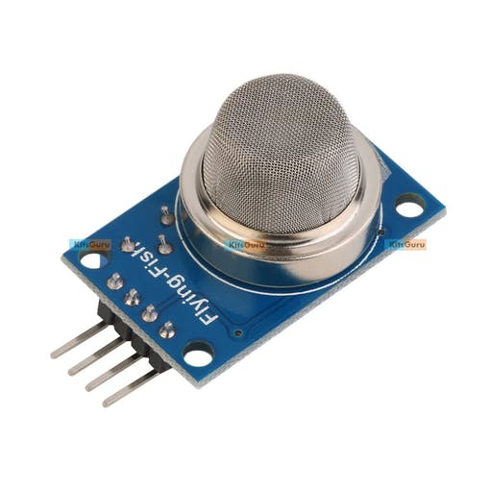
Smoke Sensor
In this project we are using a MQ2 smoke sensor.
This sensor can detect various gases including Methane, Butane and LPG. We are using a MQ2 gas sensor module in this project for better interface.

Slide 10
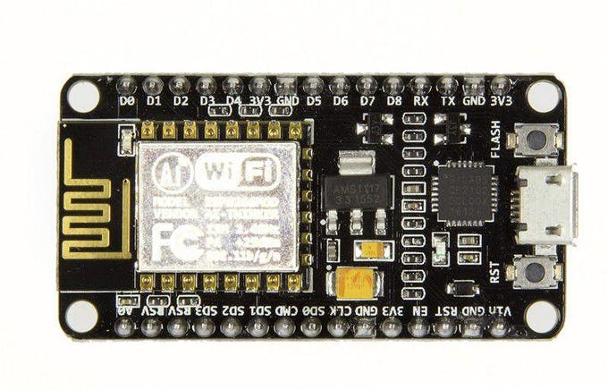
NodeMCU is a low-cost open source IoT Device
It includes firmware which runs on the low cost Wi-Fi enabled ESP8266 Wi-Fi SoC from Espressif Systems, and hardware which is based on the ESP-12 module.
It has GPIO, SPI, I2C, ADC, PWM AND UART pins for communication and controlling other peripherals attached to it.

Slide 11

Circuit Diagram

Slide 12
System Requirements
SOFTWARE USED:
Blynk App
Cloud: ThingSpeak
SOFTWARE COMPONENTS:
NodeMCU ESP8266 12-E Development Board
A 5V Relay Module
Infrared Flame Sensor
A LED
12 volt DC Fan
Few jumpers wires
12-volt adaptor
Breadboard

Slide 13
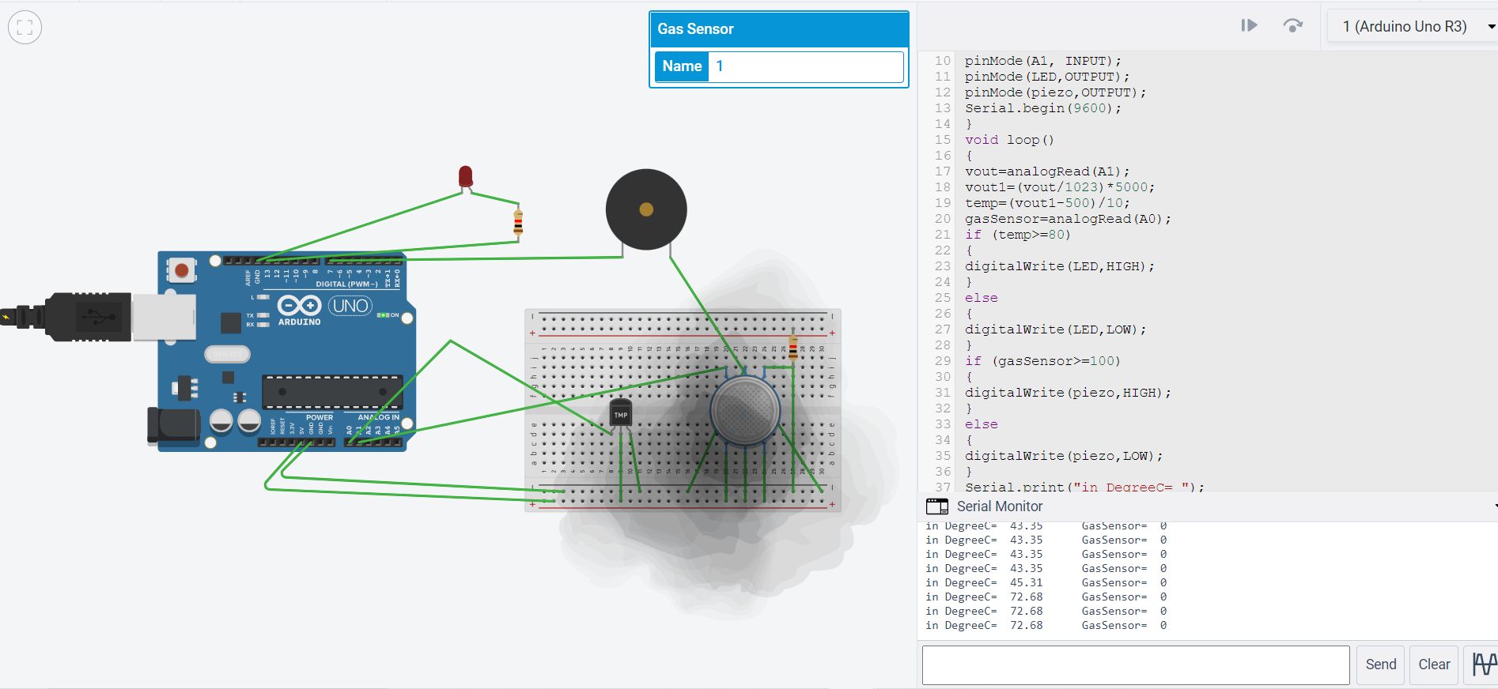
Implementation

Slide 14
Setting Up a Blynk Project
We have connected the components as per the circuit diagram and now its time to test the project.
For both the alert LED will glow and buzzer will start beeping.
You will receive below alert notification when flame sensor detects flame or fire.
Once the smoke sensor detects smoke and the value in the gauge goes beyond 500 then smoke alert will be detected. You can change the value in the code as per your need.

Slide 15

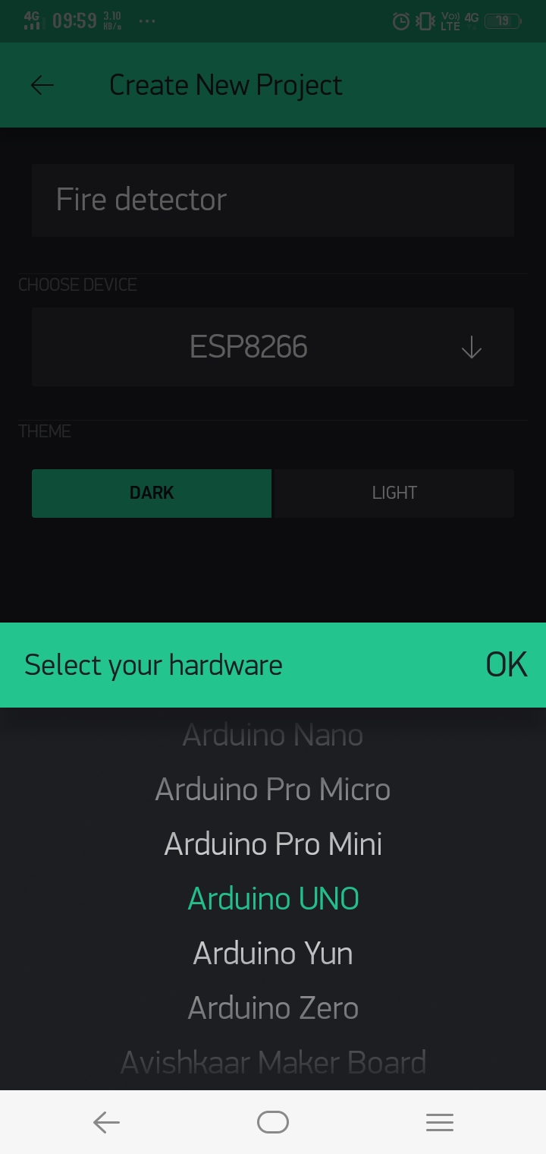
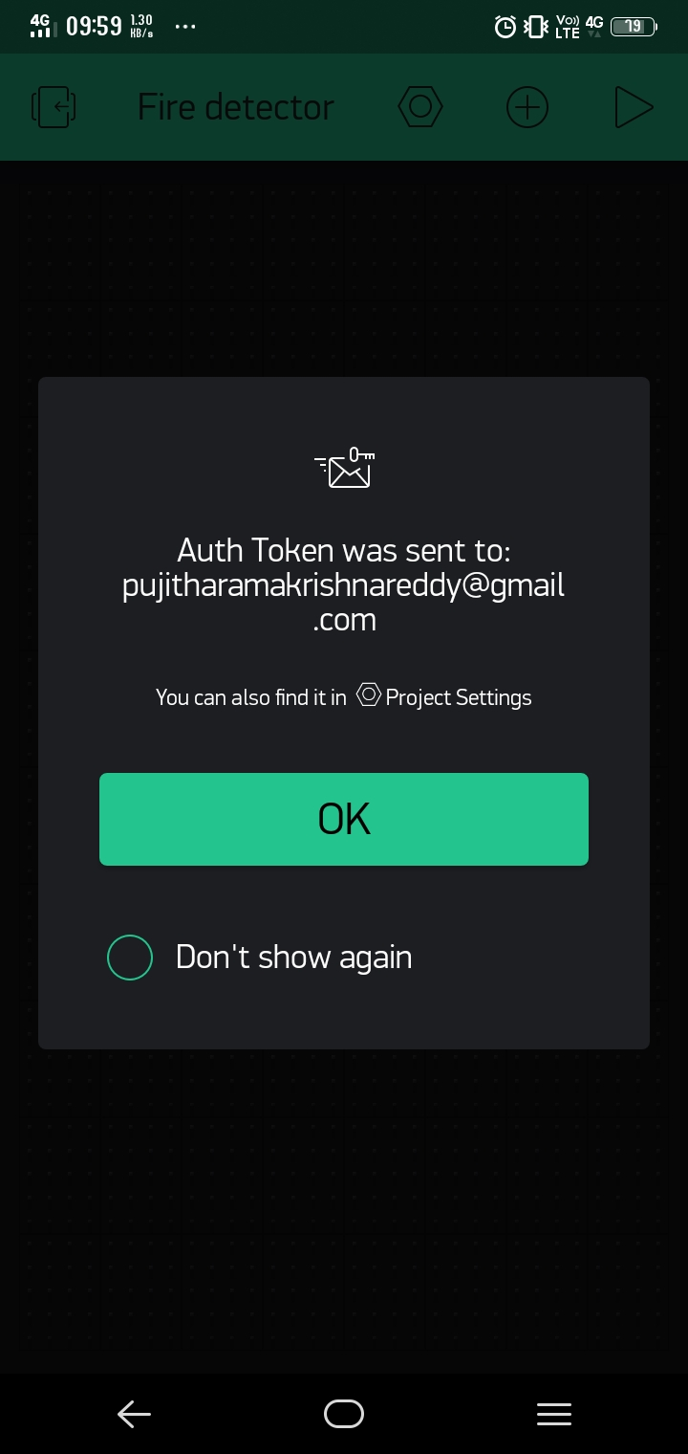
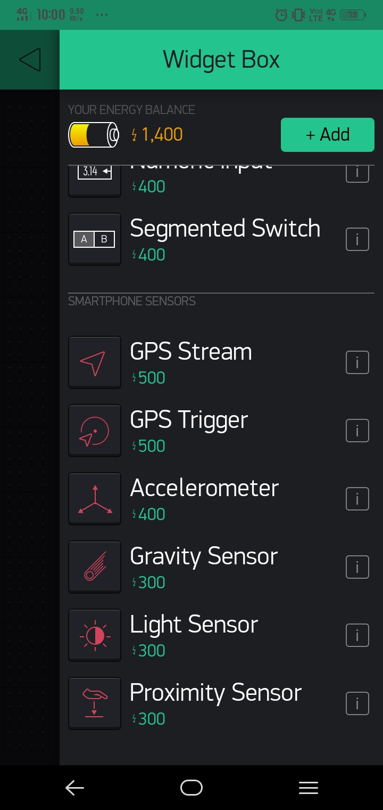

Slide 16


Slide 17
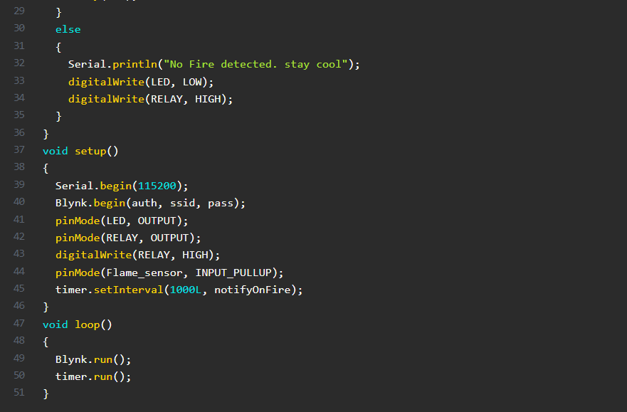

Slide 18
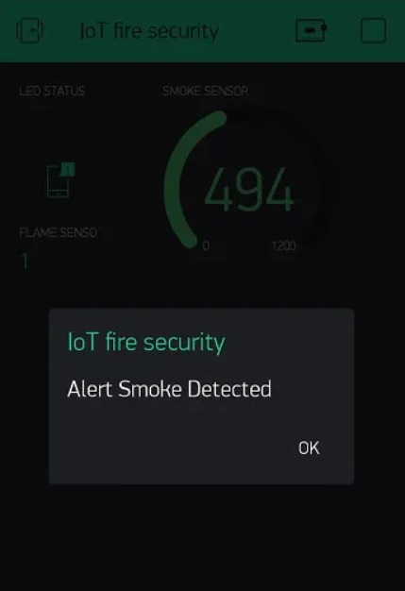
Result

Slide 19
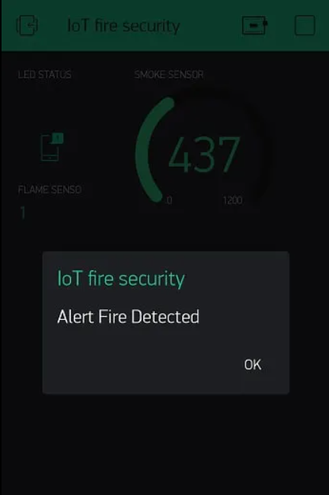

Slide 20
Applications
Fire alarms that are properly installed and maintained play a vital role in reducing fire deaths and injuries.
These will automatically detect and warn you of the presence of fire.
It is a cost-effective fire alarm system which performs reliably to ensure safety from fire.
These can save your life in the event of the fire.
Helps in reducing the fire accidents in the society.

Slide 21
Limitations
The amount of “smoke” present may be insufficient to alarm smoke detectors. Smoke detectors are designed to alarm at various levels of smoke density. If such density levels are not created by a developing fire at the location of detectors, the detectors will not go into alarm.
Smoke detectors are subject to false alarms and nuisance alarms. For example, a smoke detector located in or near a kitchen may go into nuisance alarm during normal operation of kitchen appliances. In addition, dusty or steamy environments may cause a smoke detector to falsely alarm.

Slide 22
Conclusion and Future Work
In conclusion it is important to have a fire protection system in place as a part of a building’s safety plan. Without a fire protection system, the lives of those who are inside the building are placed at a high risk in the event an emergency. To avoid financial loss and also save people from dangerous fire accidents.
In future we can work on phone calls as well. At the same time we can work on overcoming the above mentioned limitations.

Slide 23
References
https://www.ijcttjournal.org/2018/Volume58/number-1/IJCTT-V58P109.pdf
https://theiotprojects.com/iot-fire-detector-automatic-extinguisher-using-nodemcu/
https://ieeexplore.ieee.org/

Slide 24
Queries

Slide 25
Thank you

